Slide 1
Statistical Learning Common Core
Understanding Machine Learning

Slide 2
General Recipe
statistical learning algorithm by combining:
model (e.g., linear function, Gaussian distribution)
objective function (e.g., squared residuals)
optimization algorithm (e.g., gradient descent)

Slide 3
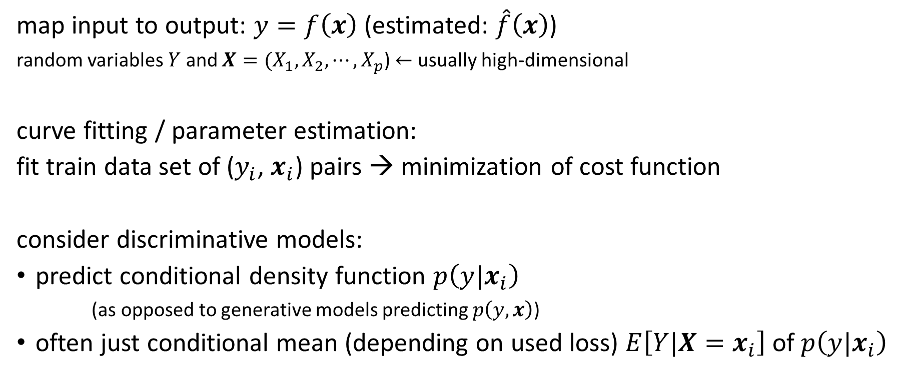
Consider Supervised Learning Scenario
map input to output: $y=f\left(x\right)$ (estimated: $\hat{f}\left(x\right)$)
random variables $Y$ and $X={(X}_{1}, X_{2},{⋯,X}_{p}$) $←$ usually high-dimensional
curve fitting / parameter estimation:
fit train data set of ($y_{i}$, $x_{i}$) pairs → minimization of cost function
consider discriminative models:
predict conditional density function $p\left(y|x_{i}\right)$
(as opposed to generative models predicting $p\left(y, x\right)$)
often just conditional mean (depending on used loss) $E\left[Y|X=x_{i}\right]$ of $p\left(y|x_{i}\right)$

Slide 4
Model

Slide 5
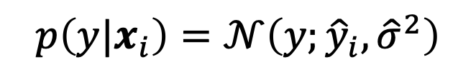
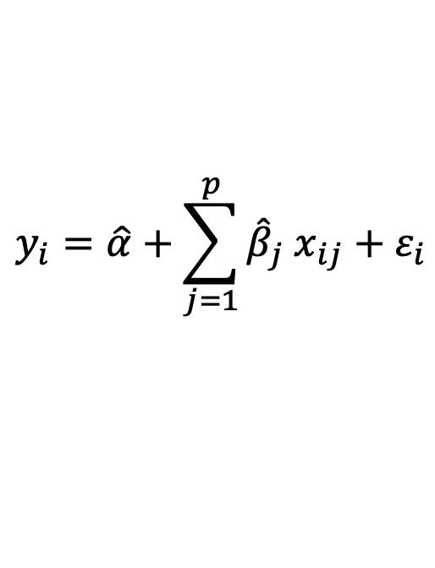
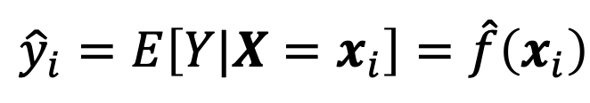

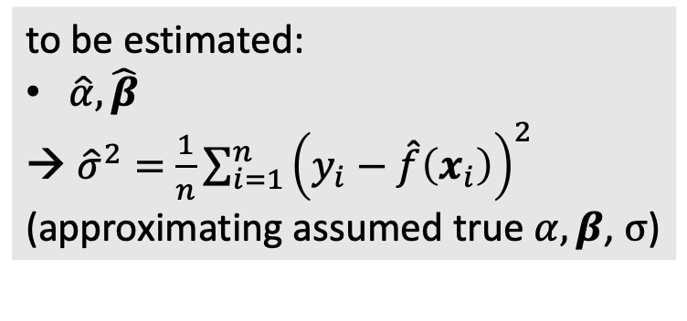
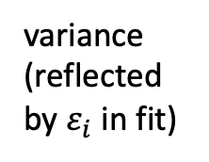
Model in Linear Regression
$$\hat{f}\left(x_{i}\right)$$
to be estimated:
$\hat{α},\hat{β}$
${\hat{σ}}^{2}=$ $\frac{1}{n}\sum_{i=1}^{n}{{\left(y_{i}−\hat{f}\left(x_{i}\right)\right)}^{2}}$
(approximating assumed true $α, β$, $σ$)
fit:
$$y_{i}=\hat{α}+\sum_{j=1}^{p}{{\hat{β}}_{j} x_{ij}}+ε_{i}$$
predict:
$${\hat{y}}_{i}=E\left[Y|X=x_{i}\right]=\hat{f}\left(x_{i}\right)$$
$$p\left(y|x_{i}\right)=𝒩\left(y;{\hat{y}}_{i}, {\hat{σ}}^{2}\right)$$
Gaussian
mean
variance
(reflected by $ε_{i}$ in fit)

Slide 6
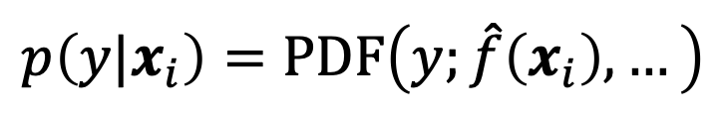

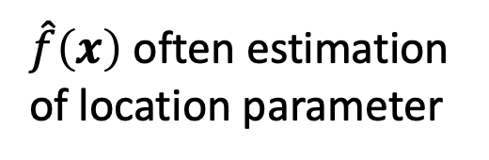
Model Ingredients
underlying probability distribution of $Y$
approximated functional form $\hat{f}\left(x\right)$ → depends on used ML algorithm
$$p\left(y|x_{i}\right)=PDF\left(y;\hat{f}\left(x_{i}\right), …\right)$$
assumed Probability Density Function of target
$\hat{f}\left(x\right)$ often estimation of location parameter
other parameters (e.g., scale parameter) often not predicted per sample (assume homoscedasticity)

Slide 7
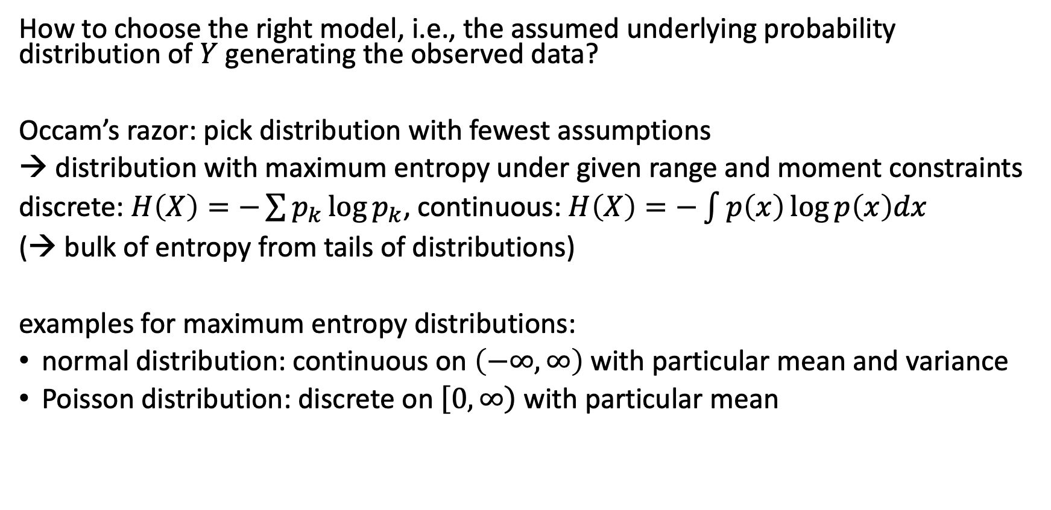
Principle of Maximum Entropy
How to choose the right model, i.e., the assumed underlying probability distribution of $Y$ generating the observed data?
Occam’s razor: pick distribution with fewest assumptions
→ distribution with maximum entropy under given range and moment constraints
discrete: $H\left(X\right)=−\sum{p_{k}\log{p_{k}}}$, continuous: $H\left(X\right)=−\int{p\left(x\right)\log{p\left(x\right)dx}}$
(→ bulk of entropy from tails of distributions)
examples for maximum entropy distributions:
normal distribution: continuous on $\left(−∞,∞\right)$ with particular mean and variance
Poisson distribution: discrete on $\left[0,\left.∞\right)\right.$ with particular mean

Slide 8
Objective Function

Slide 9
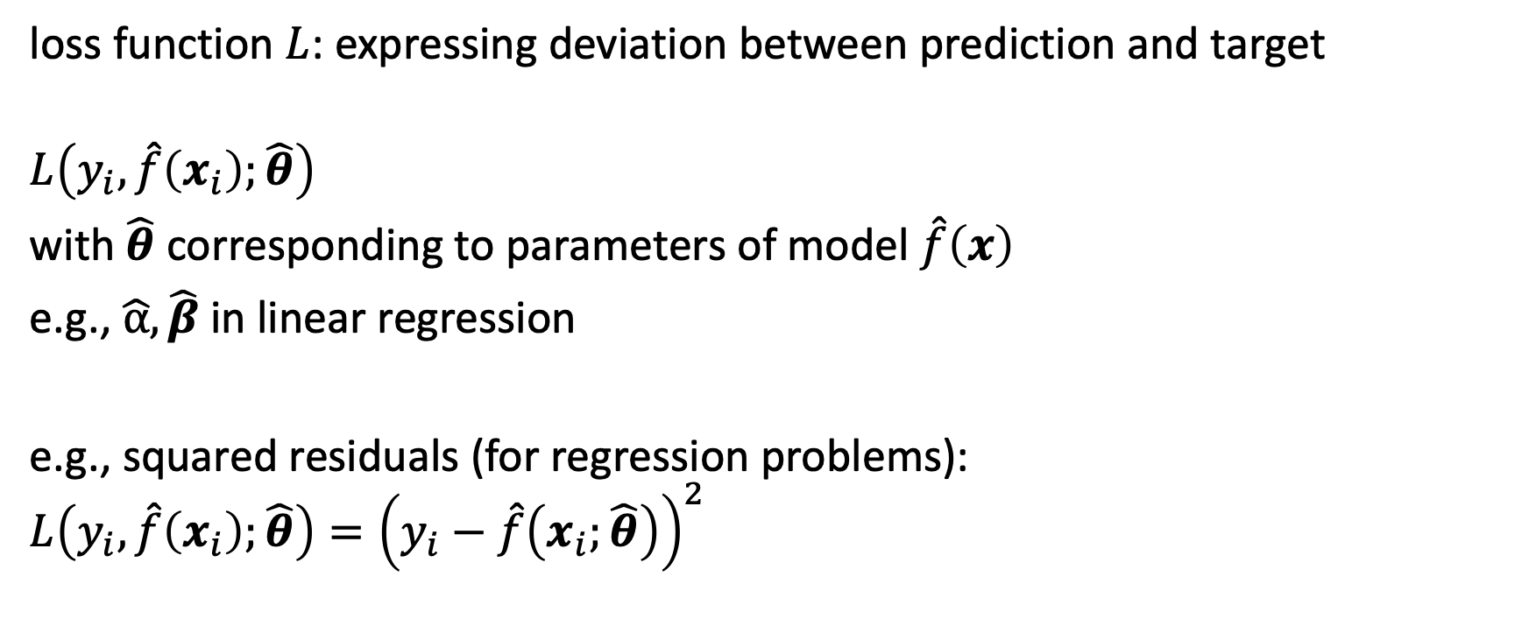
Loss Function
loss function $L$: expressing deviation between prediction and target
$$L\left(y_{i},\hat{f}\left(x_{i}\right);\hat{θ}\right)$$
with $\hat{θ}$ corresponding to parameters of model $\hat{f}\left(x\right)$
e.g., $\hat{α}, \hat{β}$ in linear regression
e.g., squared residuals (for regression problems):
$$L\left(y_{i},\hat{f}\left(x_{i}\right);\hat{θ}\right)={\left(y_{i}−\hat{f}\left(x_{i};\hat{θ}\right)\right)}^{2}$$

Slide 10
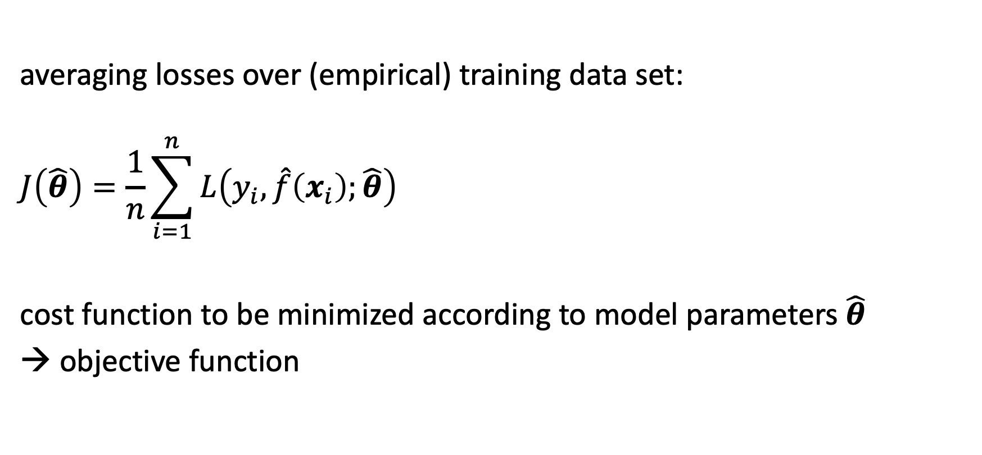
Cost Function
averaging losses over (empirical) training data set:
$$J\left(\hat{θ}\right)=\frac{1}{n}\sum_{i=1}^{n}{L\left(y_{i},\hat{f}\left(x_{i}\right);\hat{θ}\right)}$$
cost function to be minimized according to model parameters $\hat{θ}$
→ objective function

Slide 11
Optimization

Slide 12
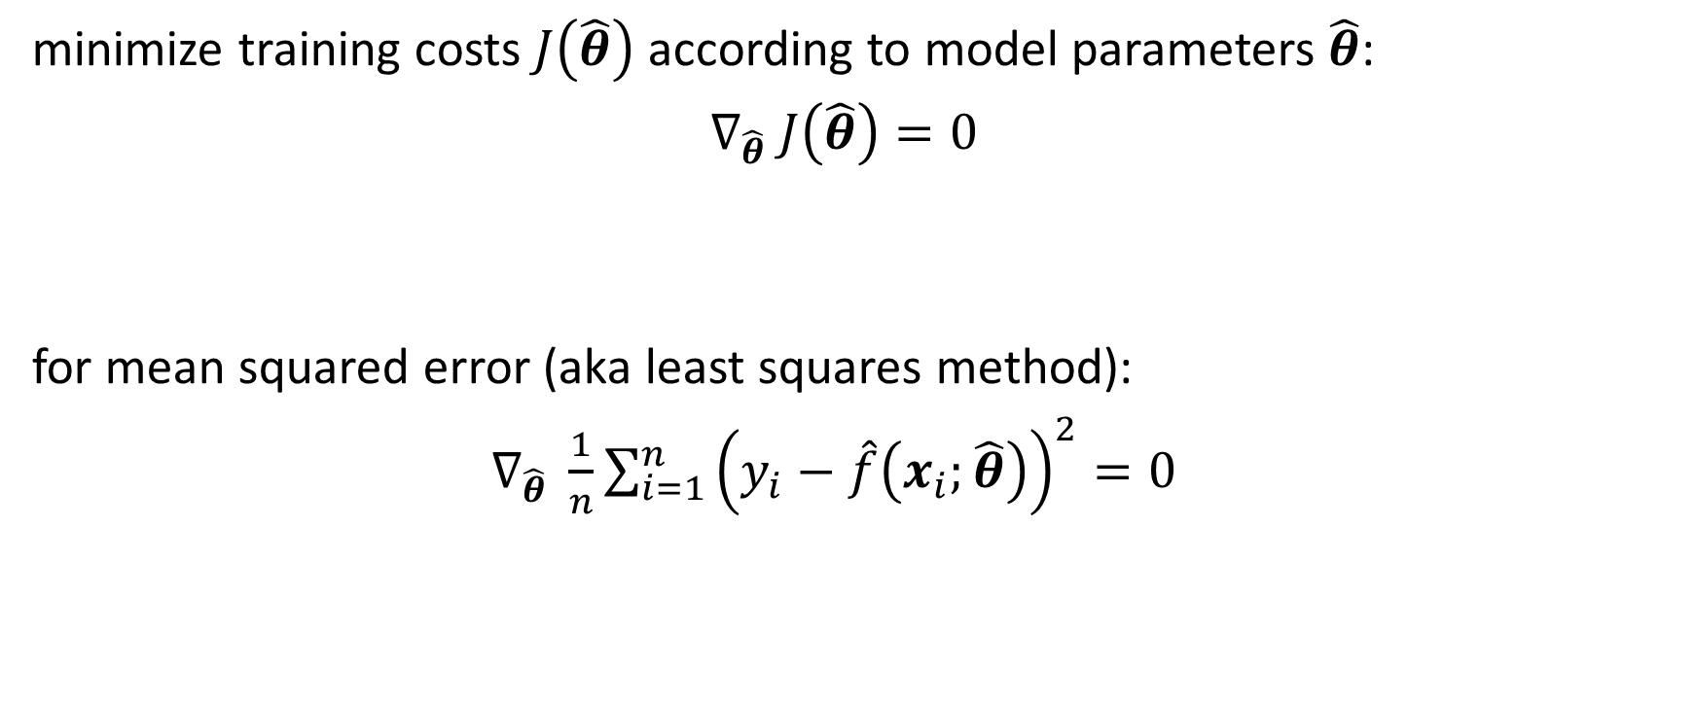
Cost Minimization
minimize training costs $J\left(\hat{θ}\right)$ according to model parameters $\hat{θ}$:
$∇_{\hat{θ}} J\left(\hat{θ}\right)=0$
for mean squared error (aka least squares method):
$∇_{\hat{θ}} \frac{1}{n}\sum_{i=1}^{n}{{\left(y_{i}−\hat{f}\left(x_{i};\hat{θ}\right)\right)}^{2}}=0$

Slide 13
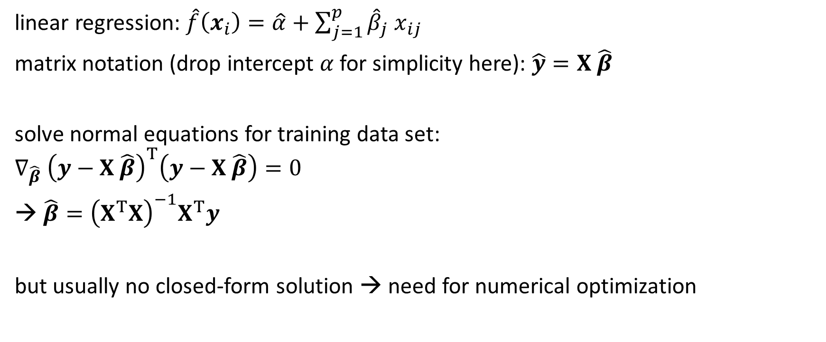
Ordinary Least Squares
linear regression: $\hat{f}\left(x_{i}\right)=\hat{α}+\sum_{j=1}^{p}{{\hat{β}}_{j} x_{ij}}$
matrix notation (drop intercept $α$ for simplicity here): $\hat{y}=X \hat{β}$
solve normal equations for training data set:
$$∇_{\hat{β}} {\left(y−X \hat{β}\right)}^{T}\left(y−X \hat{β}\right)=0$$
$\hat{β}={\left(X^{T}X\right)}^{−1}X^{T}y$
but usually no closed-form solution → need for numerical optimization

Slide 14
Maximum Likelihood Estimation

Slide 15
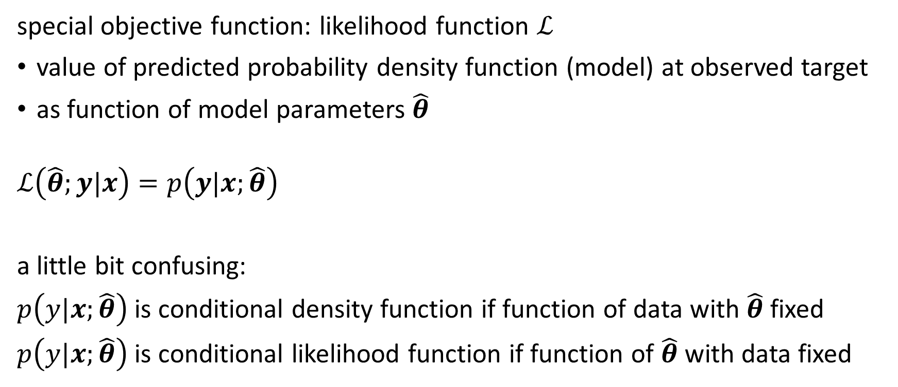
Likelihood
special objective function: likelihood function $ℒ$
value of predicted probability density function (model) at observed target
as function of model parameters $\hat{θ}$
$$ℒ\left(\hat{θ};y|x\right)=p\left(y|x;\hat{θ}\right)$$
a little bit confusing:
$p\left(y|x;\hat{θ}\right)$ is conditional density function if function of data with $\hat{θ}$ fixed
$p\left(y|x;\hat{θ}\right)$ is conditional likelihood function if function of $\hat{θ}$ with data fixed

Slide 16
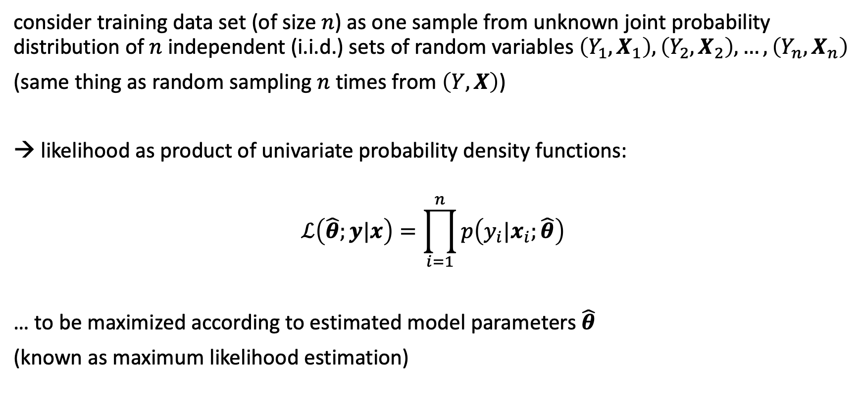
Independence Assumption
consider training data set (of size $n$) as one sample from unknown joint probability distribution of $n$independent (i.i.d.) sets of random variables $\left(Y_{1},X_{1}\right),\left(Y_{2},X_{2}\right),…, \left(Y_{n},X_{n}\right)$
(same thing as random sampling $n$ times from $\left(Y,X\right)$)
→ likelihood as product of univariate probability density functions:
$$ℒ\left(\hat{θ};y|x\right)=\prod_{i=1}^{n}{p\left(y_{i}|x_{i};\hat{θ}\right)}$$
… to be maximized according to estimated model parameters $\hat{θ}$
(known as maximum likelihood estimation)

Slide 17
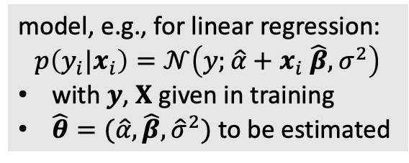
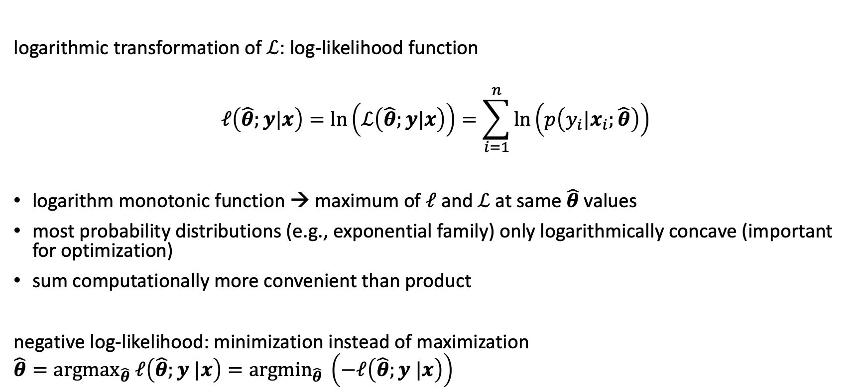
Negative Log-Likelihood
model, e.g., for linear regression:
$$p\left(y_{i}|x_{i}\right)=𝒩\left(y;\hat{α}+x_{i} \hat{β},σ^{2}\right)$$
with $y$, $X$ given in training
$\hat{θ}=(\hat{α},\hat{β},{\hat{σ}}^{2})$ to be estimated
logarithmic transformation of $ℒ$: log-likelihood function
$$ℓ\left(\hat{θ};y|x\right)=ln\left(ℒ\left(\hat{θ};y|x\right)\right)=\sum_{i=1}^{n}{\ln\left(p\left(y_{i}|x_{i};\hat{θ}\right)\right)}$$
logarithm monotonic function → maximum of $ℓ$ and $ℒ$ at same $\hat{θ}$ values
most probability distributions (e.g., exponential family) only logarithmically concave (important for optimization)
sum computationally more convenient than product
negative log-likelihood: minimization instead of maximization
$${\hat{θ}=argmax}_{\hat{θ}} ℓ\left(\hat{θ};y |x\right)={argmin}_{\hat{θ}} \left(−ℓ\left(\hat{θ};y |x\right)\right)$$
objective function

Slide 18
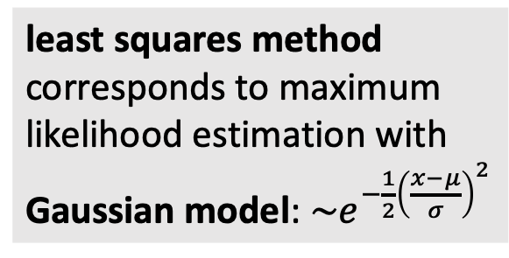
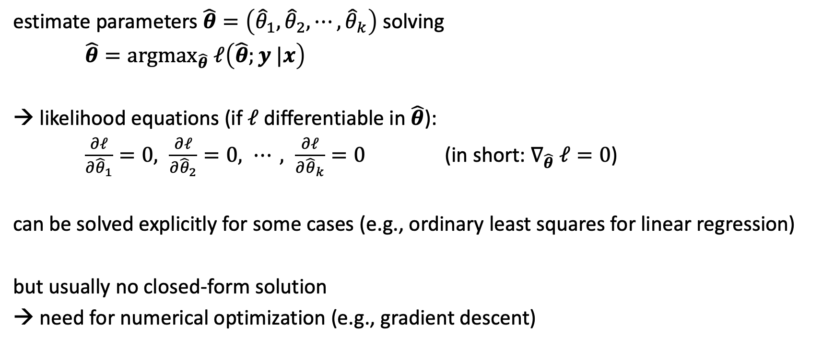
Maximum Likelihood
least squares method corresponds to maximum likelihood estimation with Gaussian model: $\sim e^{−\frac{1}{2}{\left(\frac{x−μ}{σ}\right)}^{2}}$
estimate parameters $\hat{θ}=\left({\hat{θ}}_{1},{\hat{θ}}_{2},⋯,{\hat{θ}}_{k}\right)$ solving
${\hat{θ}=argmax}_{\hat{θ}} ℓ\left(\hat{θ};y |x\right)$
likelihood equations (if $ℓ$ differentiable in $\hat{θ}$):
$\frac{∂ℓ}{∂{\hat{θ}}_{1}}=0, \frac{∂ℓ}{∂{\hat{θ}}_{2}}=0, ⋯, \frac{∂ℓ}{∂{\hat{θ}}_{k}}=0$ (in short: $∇_{\hat{θ}} ℓ=0$)
can be solved explicitly for some cases (e.g., ordinary least squares for linear regression)
but usually no closed-form solution
→ need for numerical optimization (e.g., gradient descent)

Slide 19
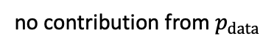
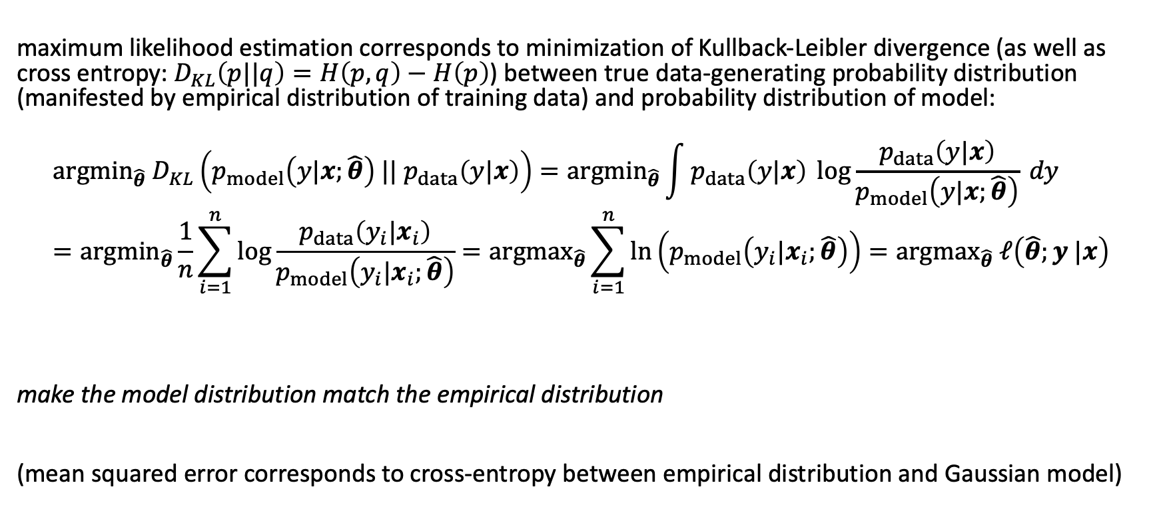
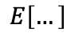
Interpretation of Maximum Likelihood
quantification of difference between two probability distributions
maximum likelihood estimation corresponds to minimization of Kullback-Leibler divergence (as well as cross entropy: $D_{KL}\left(p||q\right)=H\left(p,q\right)−H\left(p\right)$) between true data-generating probability distribution (manifested by empirical distribution of training data) and probability distribution of model:
$${argmin}_{\hat{θ}} D_{KL}\left(p_{model}\left(y|x;\hat{θ}\right) || p_{data}\left(y|x\right)\right)={argmin}_{\hat{θ}}\int{p_{data}\left(y|x\right) \log{\frac{p_{data}\left(y|x\right)}{p_{model}\left(y|x;\hat{θ}\right)}} dy}={argmin}_{\hat{θ}}\frac{1}{n}\sum_{i=1}^{n}{\log{\frac{p_{data}\left(y_{i}|x_{i}\right)}{p_{model}\left(y_{i}|x_{i};\hat{θ}\right)}}}={argmax}_{\hat{θ}}\sum_{i=1}^{n}{\ln\left(p_{model}\left(y_{i}|x_{i};\hat{θ}\right)\right)}={argmax}_{\hat{θ}} ℓ\left(\hat{θ};y |x\right)$$
make the model distribution match the empirical distribution
(mean squared error corresponds to cross-entropy between empirical distribution and Gaussian model)
$$E\left[…\right]$$
no contribution from $p_{data}$

Slide 20
Iterative Optimization

Slide 21
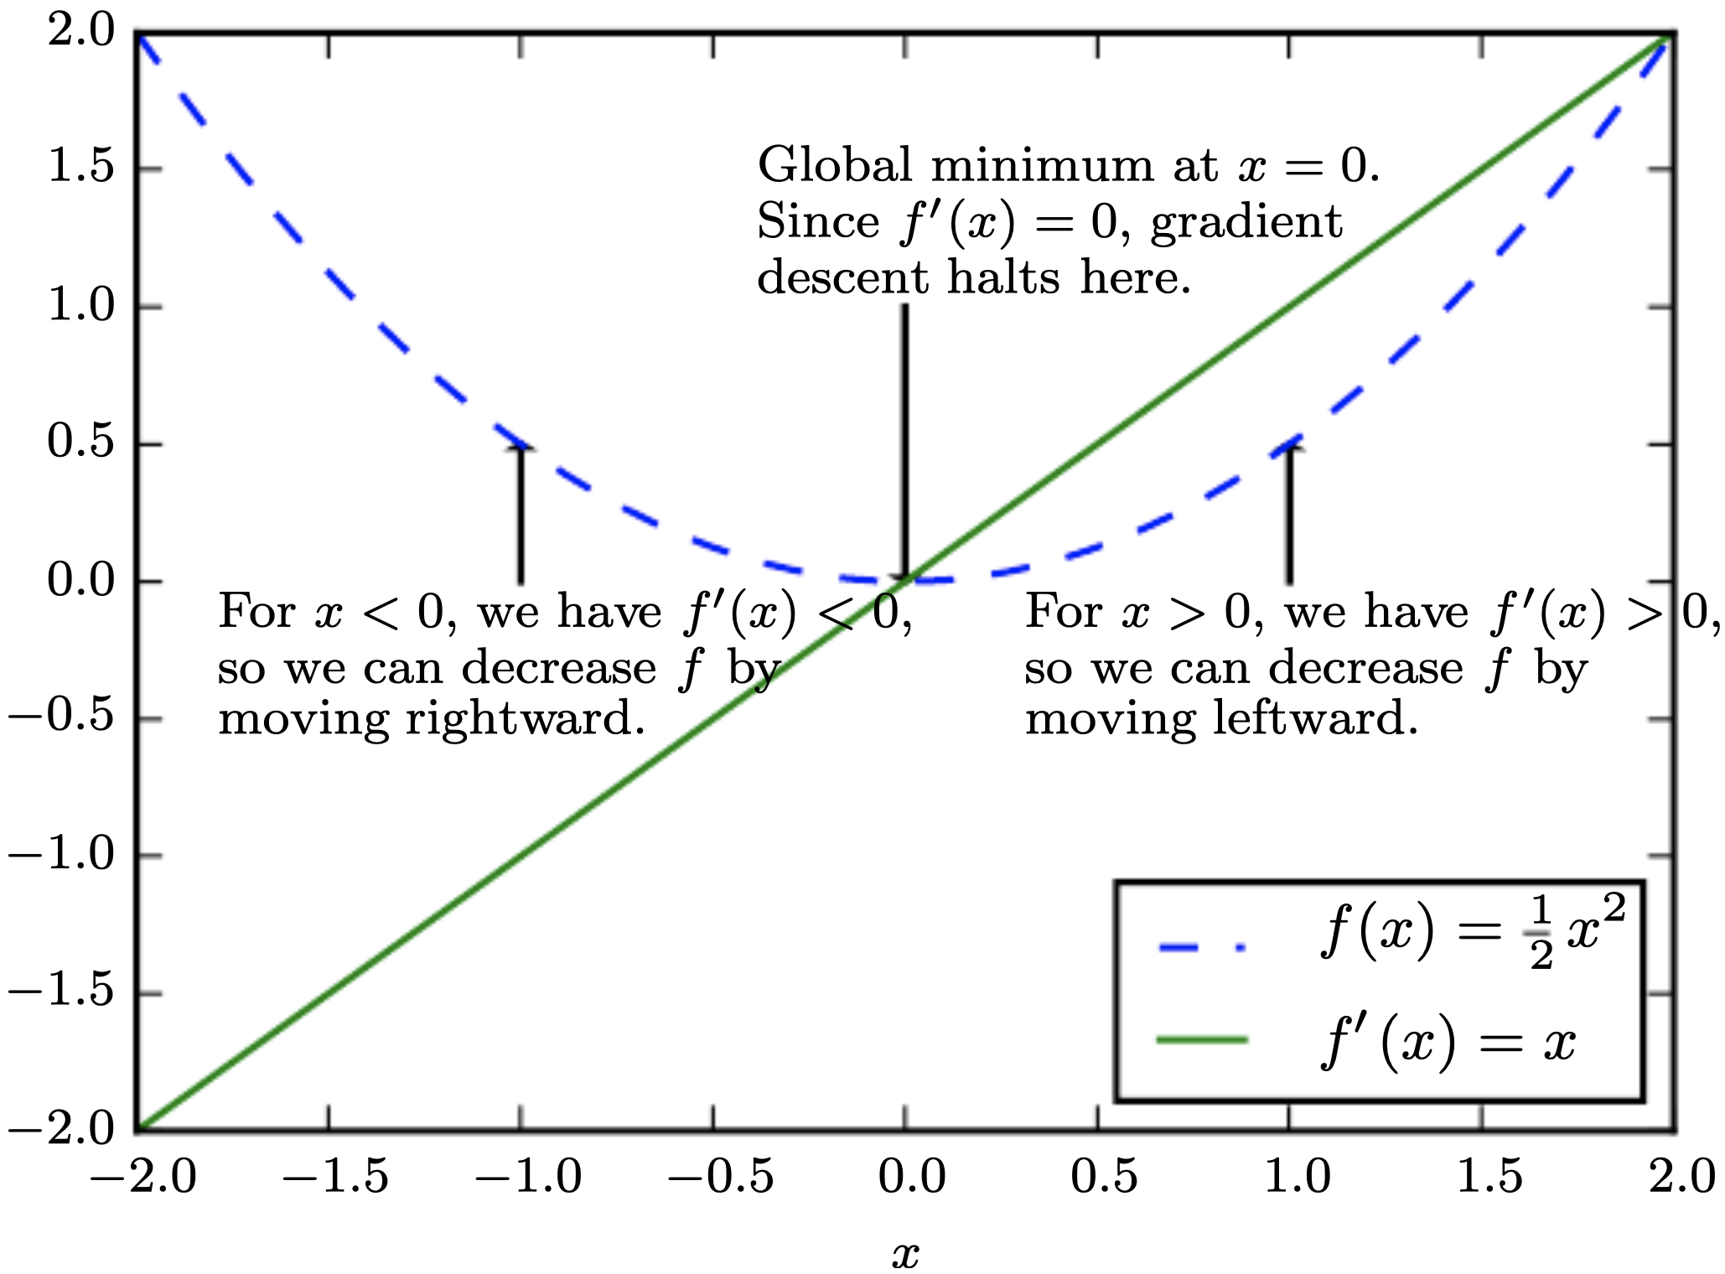

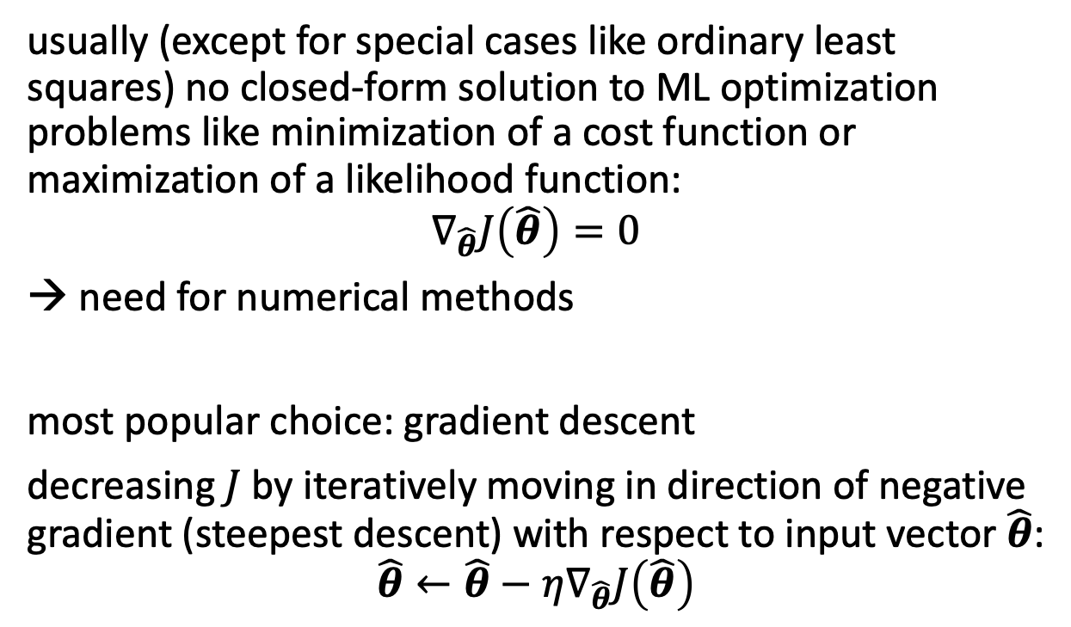
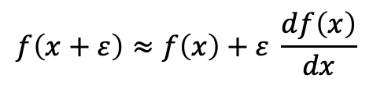
Gradient Descent
$$f\left(x+ε\right)≈f\left(x\right)+ε \frac{df\left(x\right)}{dx}$$
usually (except for special cases like ordinary least squares) no closed-form solution to ML optimization problems like minimization of a cost function or maximization of a likelihood function:
$$∇_{\hat{θ}}J\left(\hat{θ}\right)=0$$
need for numerical methods
most popular choice: gradient descent
decreasing $J$ by iteratively moving in direction of negative gradient (steepest descent) with respect to input vector $\hat{θ}$:
$$\hat{θ}←\hat{θ}−η∇_{\hat{θ}}J\left(\hat{θ}\right)$$
source
local minimum
global minimum
step size (learning rate)
vector containing all partial derivatives

Slide 22
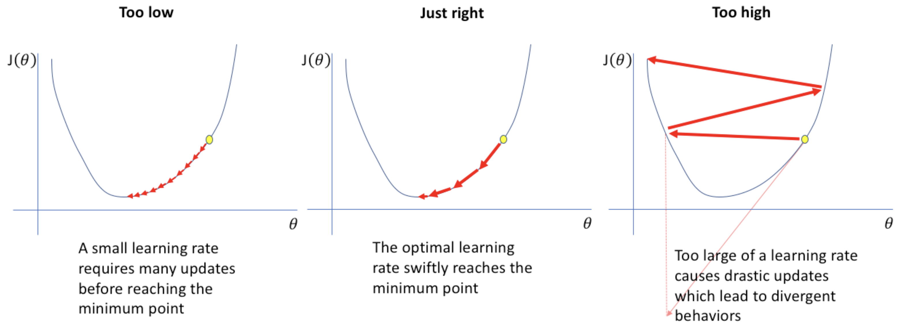
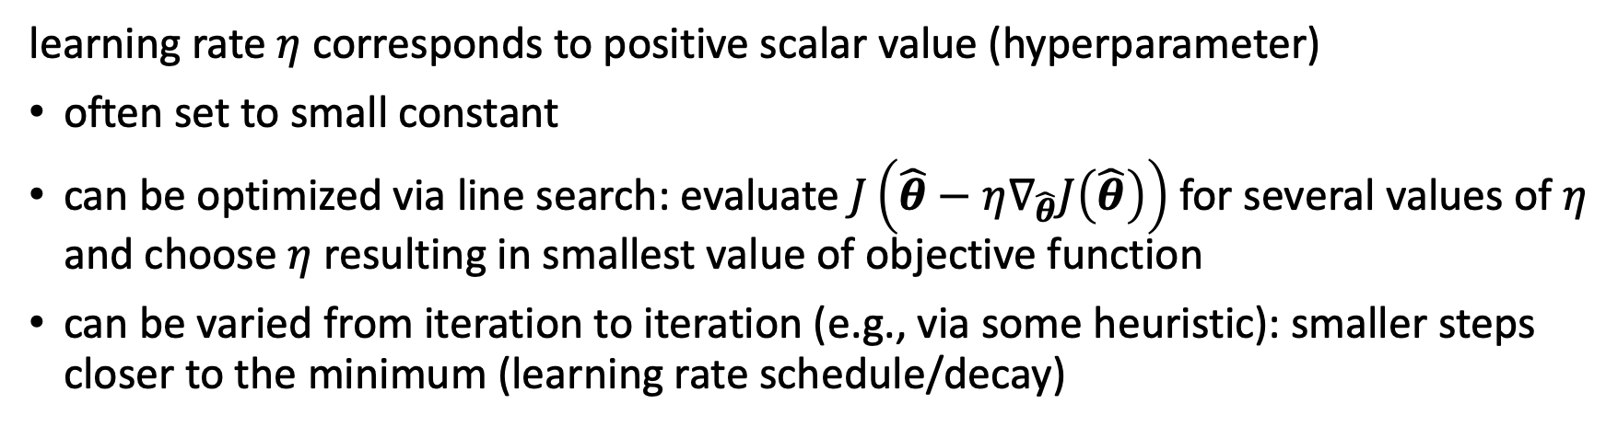
Learning Rate
learning rate $η$ corresponds to positive scalar value (hyperparameter)
often set to small constant
can be optimized via line search: evaluate $J\left(\hat{θ}−η∇_{\hat{θ}}J\left(\hat{θ}\right)\right)$ for several values of $η$ and choose $η$ resulting in smallest value of objective function
can be varied from iteration to iteration (e.g., via some heuristic): smaller steps closer to the minimum (learning rate schedule/decay)
source

Slide 23
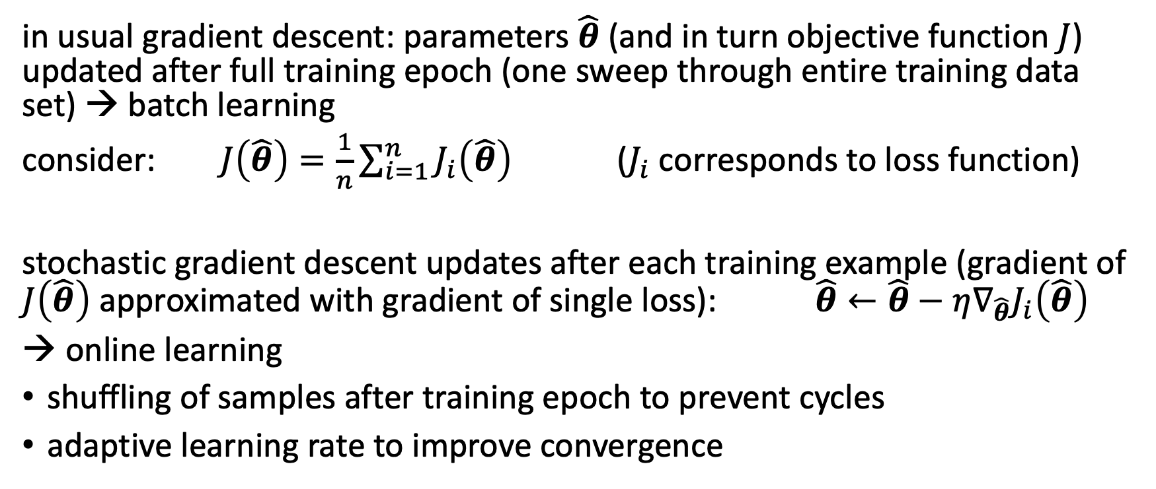
Batch and Stochastic Gradient Descent
in usual gradient descent: parameters $\hat{θ}$ (and in turn objective function $J$) updated after full training epoch (one sweep through entire training data set) → batch learning
consider: $J\left(\hat{θ}\right)=\frac{1}{n}\sum_{i=1}^{n}{J_{i}\left(\hat{θ}\right)}$ ($J_{i}$corresponds to loss function)
stochastic gradient descent updates after each training example (gradient of $J\left(\hat{θ}\right)$ approximated with gradient of single loss): $\hat{θ}←\hat{θ}−η∇_{\hat{θ}}J_{i}\left(\hat{θ}\right)$
→ online learning
shuffling of samples after training epoch to prevent cycles
adaptive learning rate to improve convergence

Slide 24
Mini Batches
Compared to its batch mode, stochastic gradient descent helps to avoid local minima (more robust), but is computationally expensive (less efficient).
→ mini-batch stochastic gradient descent as compromise:
splitting training data set into small batches used to calculate model error and update parameters
at the cost of one additional hyperparameter specifying mini-batch size

Slide 25
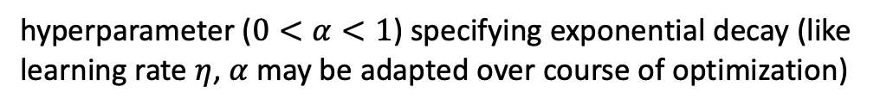
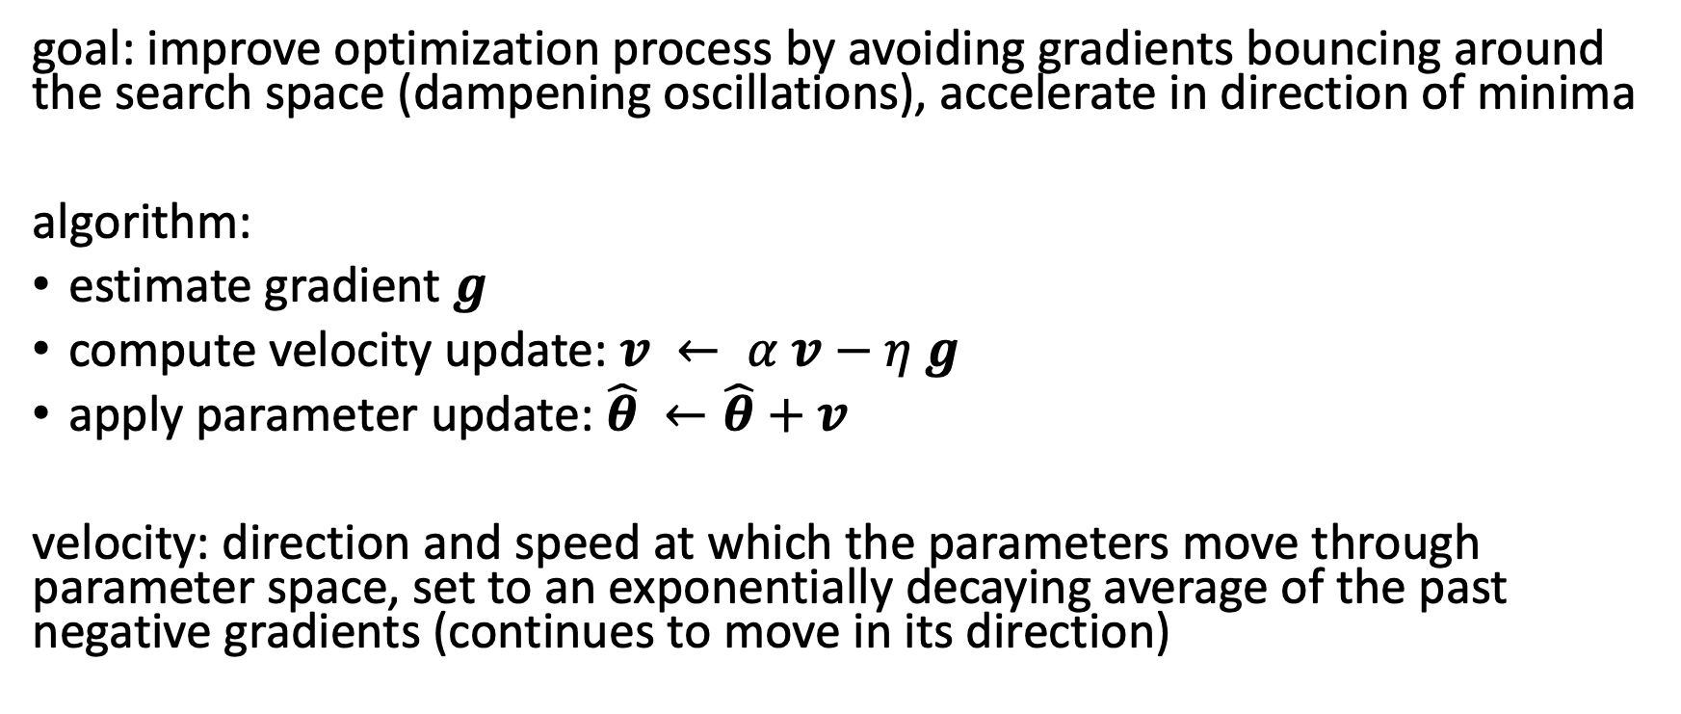
Gradient Descent with Momentum
goal: improve optimization process by avoiding gradients bouncing around the search space (dampening oscillations), accelerate in direction of minima
algorithm:
estimate gradient $g$
compute velocity update: $v ← α v−η g$
apply parameter update: $\hat{θ} ←\hat{θ}+v$
velocity: direction and speed at which the parameters move through parameter space, set to an exponentially decaying average of the past negative gradients (continues to move in its direction)
hyperparameter ($0<α<1$) specifying exponential decay (like learning rate $η$, $α$ may be adapted over course of optimization)

Slide 26
Bayesian Methods

Slide 27
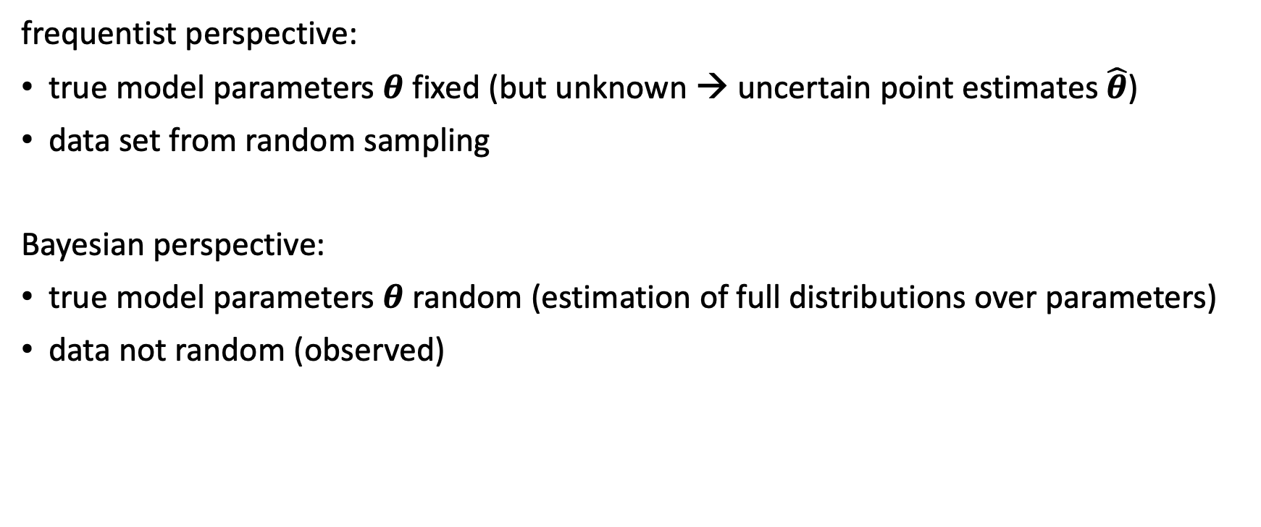
Bayesian Statistics
frequentist perspective:
true model parameters $θ$ fixed (but unknown → uncertain point estimates $\hat{θ}$)
data set from random sampling
Bayesian perspective:
true model parameters $θ$ random (estimation of full distributions over parameters)
data not random (observed)

Slide 28
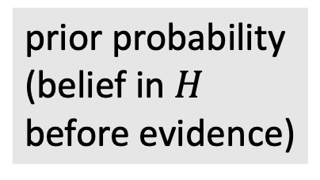
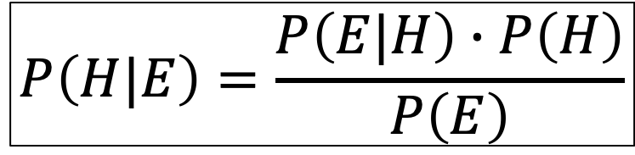
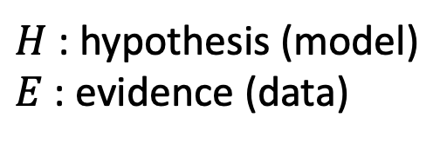
Bayes Theorem
likelihood function (derived from statistical model)
$H$: hypothesis (model)
$E$: evidence (data)
$$P\left(H|E\right)=\frac{P\left(E|H\right)∙P\left(H\right)}{P\left(E\right)}$$
posterior probability (belief updated with observed evidence)
new data (same for all hypotheses → uninteresting)
prior probability (belief in $H$ before evidence)

Slide 29
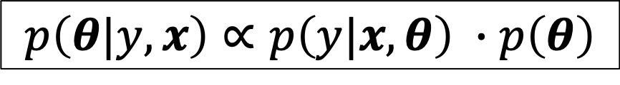
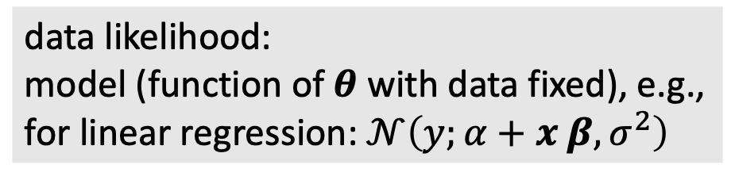
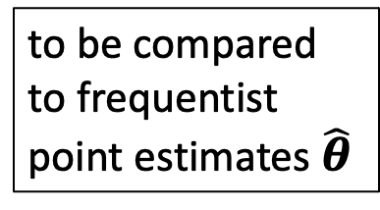
Bayes Theorem for Parameter Estimation
data likelihood:
model (function of $θ$ with data fixed), e.g., for linear regression: $𝒩\left(y;α+x β,σ^{2}\right)$
$$p\left(θ|y, x\right)∝p\left(y|x,θ\right) ∙p\left(θ\right)$$
posterior:
probability distribution reflecting the effect of data on prior belief about parameters (increasing certainty with new evidence)
prior (e.g., broad Gaussian):
probability distribution reflecting initial belief about uncertain parameters (helps to reduce variance with few data)
to be compared to frequentist point estimates $\hat{θ}$

Slide 30
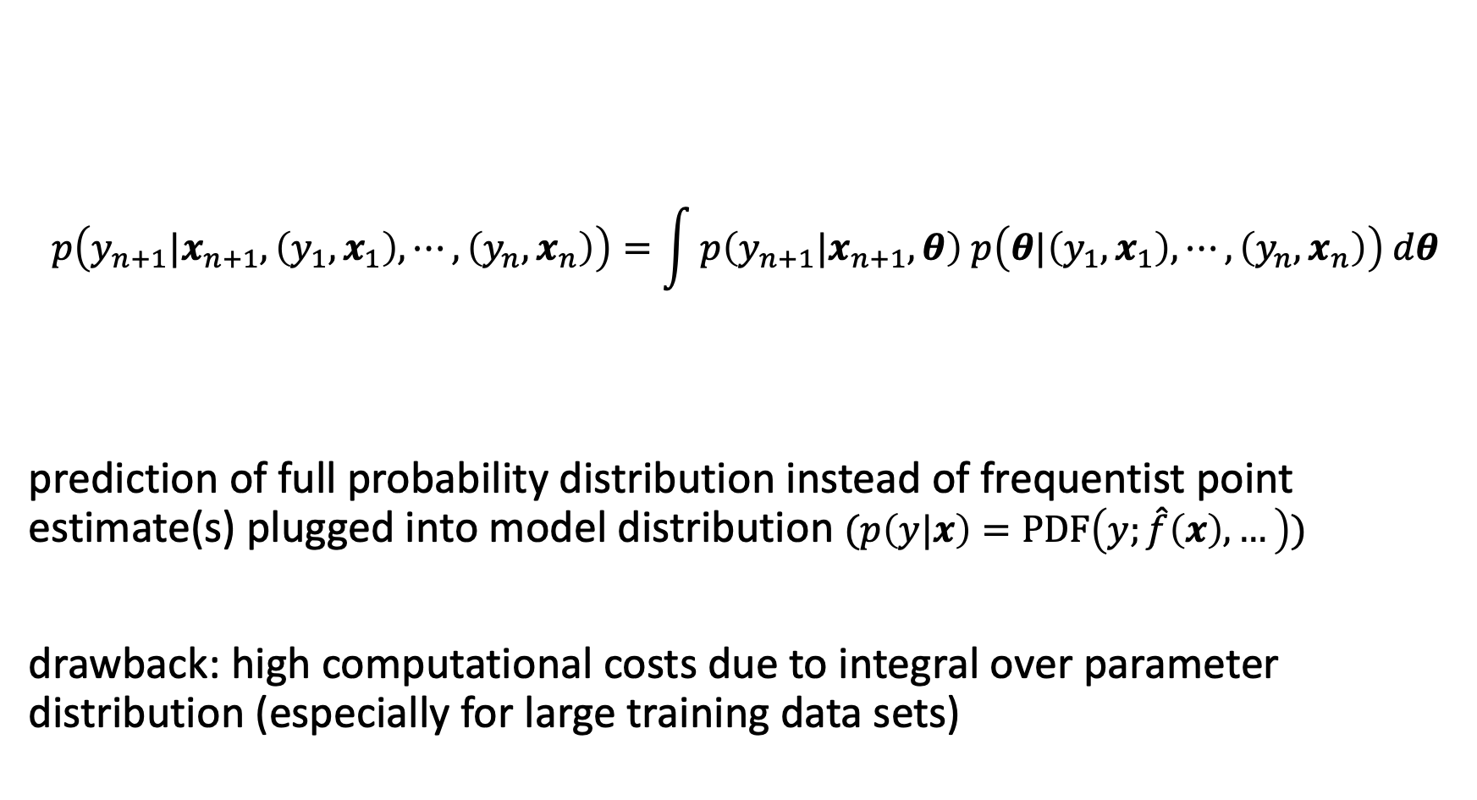
Bayesian Prediction
$$p\left(y_{n+1}|x_{n+1},\left(y_{1},x_{1}\right),⋯,\left(y_{n},x_{n}\right)\right)=\int{p\left(y_{n+1}|x_{n+1},θ\right) p\left(θ|\left(y_{1},x_{1}\right),⋯,\left(y_{n},x_{n}\right)\right) dθ}$$
prediction of full probability distribution instead of frequentist point estimate(s) plugged into model distribution $(p\left(y|x\right)=PDF\left(y;\hat{f}\left(x\right), …\right))$
drawback: high computational costs due to integral over parameter distribution (especially for large training data sets)
likelihood
latest posterior

Slide 31
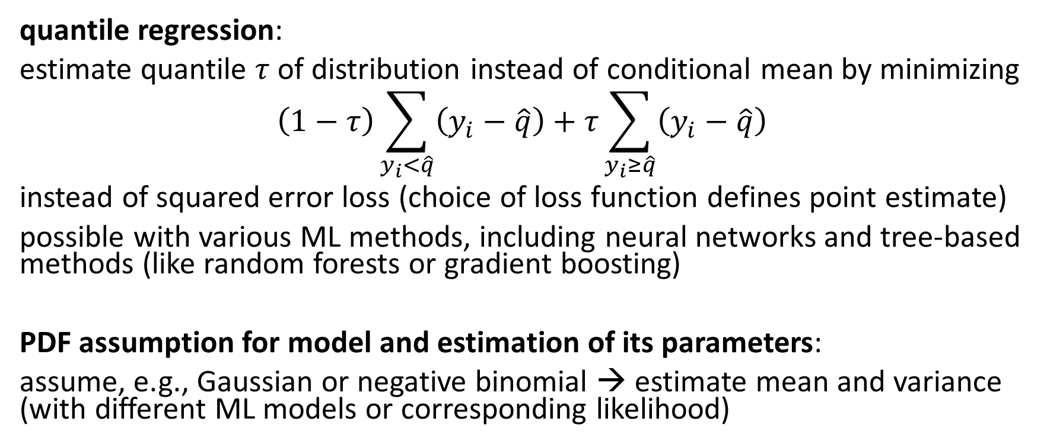
Alternatives for PDF Predictions
quantile regression:
estimate quantile $τ$ of distribution instead of conditional mean by minimizing
$$\left(1−τ\right)\sum_{y_{i}<\hat{q}}{\left(y_{i}−\hat{q}\right)+τ\sum_{y_{i}≥\hat{q}}{\left(y_{i}−\hat{q}\right)}}$$
instead of squared error loss (choice of loss function defines point estimate)
possible with various ML methods, including neural networks and tree-based methods (like random forests or gradient boosting)
PDF assumption for model and estimation of its parameters:
assume, e.g., Gaussian or negative binomial → estimate mean and variance (with different ML models or corresponding likelihood)

Slide 32
Common Core of Statistical Learning
Most ML algorithms can be described by the general recipe of combining models, costs, and optimization methods.
including non-linear models:
neural networks: backpropagation
support-vector machines: minimizing hinge loss (soft-margin SVM)
decision trees: minimizing impurity functions (mean squared error for regression, (kind of) Kullback-Leibler divergence for classification)
and even unsupervised learning (e.g., principal component analysis)

Slide 33

Literature
not only deep learning, but also a nice ML introduction
https://www.deeplearningbook.org/

Slide 34
Overcome our Mathematical Limitations
evolution provided us with moderate math skills
AI/ML to the rescue:
recognition of mathematical structures and patterns
algorithm discovery: AlphaTensor
symbolic regression (e.g., for physics)

